Slide 1
Retooling Digitization Workflows at UNCC
Simple Techniques for Project Management and Metadata Creation
Rita Johnston, Digital Production Librarian, UNC Charlotte
Joseph Nicholson, Metadata Librarian, UNC Charlotte

Slide 2
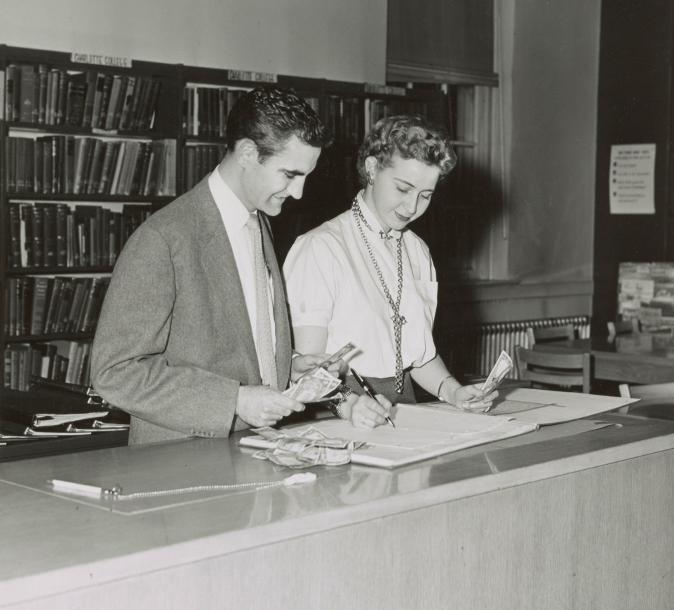
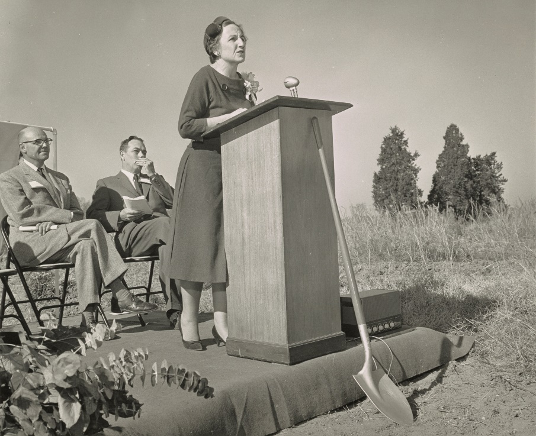
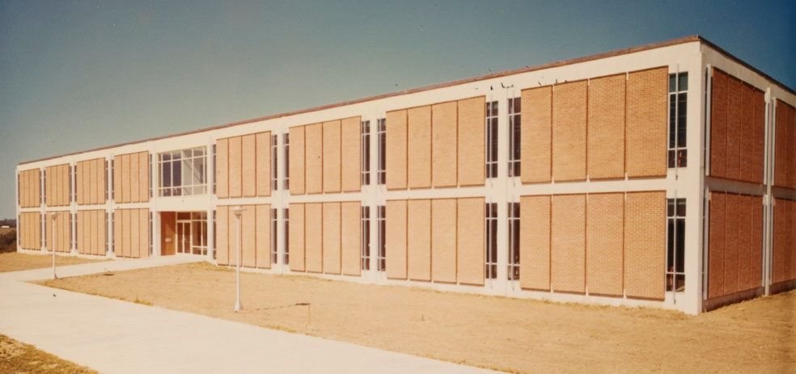
UNCC Special Collections & University Archives Overview
Charlotte College → UNC Charlotte in 1965
Large department includes many non-traditional archives areas of responsibility
Notes:
Permanent Digital Production Librarian position (responsible for digitization) established in July 2016.
Cataloging department dismantled in ??,
Transitioning from old content management systems to new
There could be several slides here with images of workspaces (dig. equipment, etc)

Slide 3
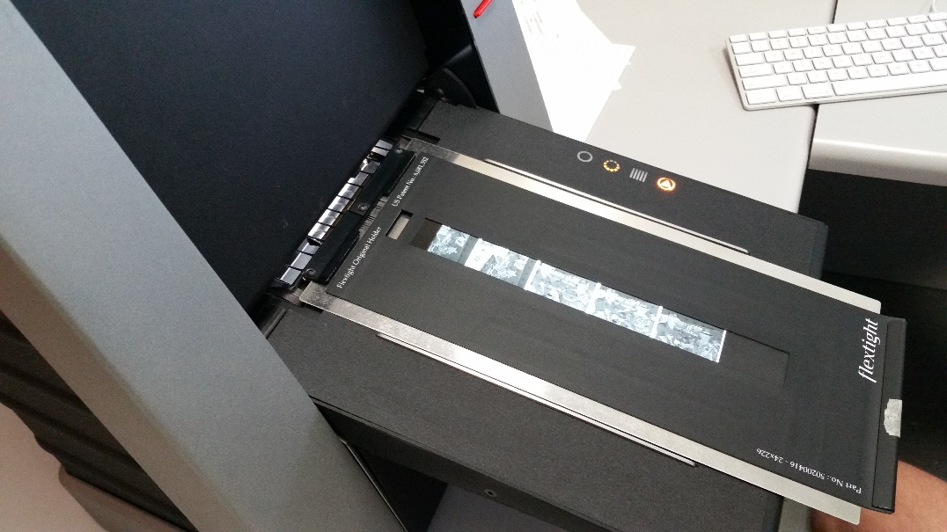
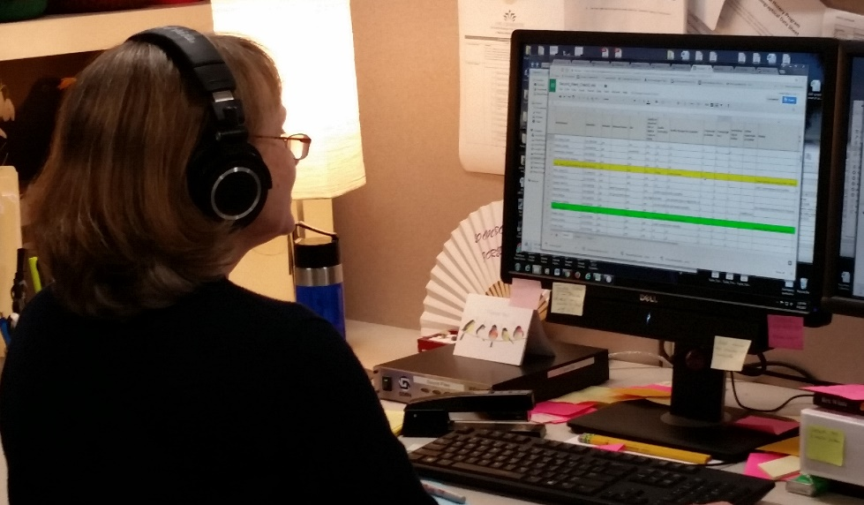
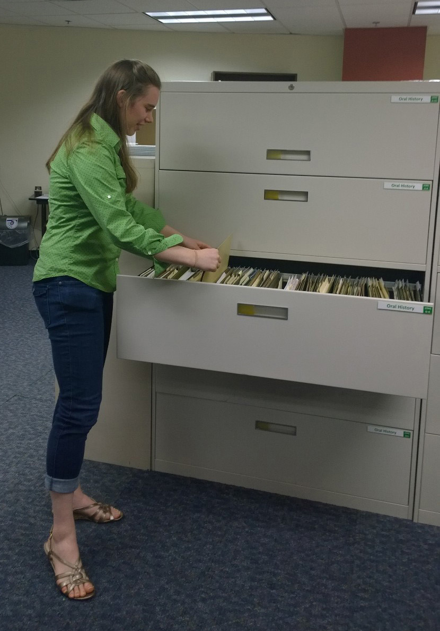
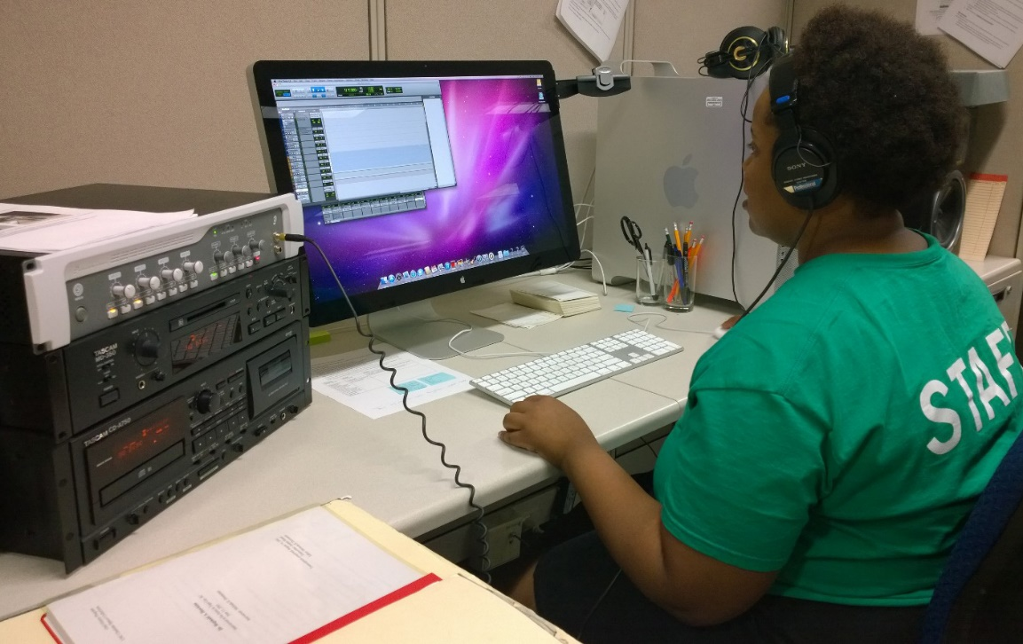
Staffing Challenges
Notes:
Rita.
Few permanent staff to take on enormous task of building digital collections.
Work accomplished by a mix of faculty, staff, and student labor
Need simple-enough processes and tools to accomplish work
While creating quality metadata that can be transformed to MODS and that leverages linked data

Slide 4
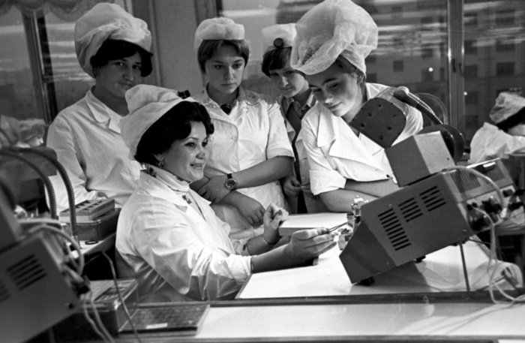
Technical Challenges
Technically proficient staff, but no coders, techies
Budget constraints = heavy reliance on student labor
Students and paraprofessionals participate in all parts of workflows
Need tools that students, paraprofessionals, and faculty with varying levels of technical sophistication can easily learn and use
Notes:
Joseph

Slide 5
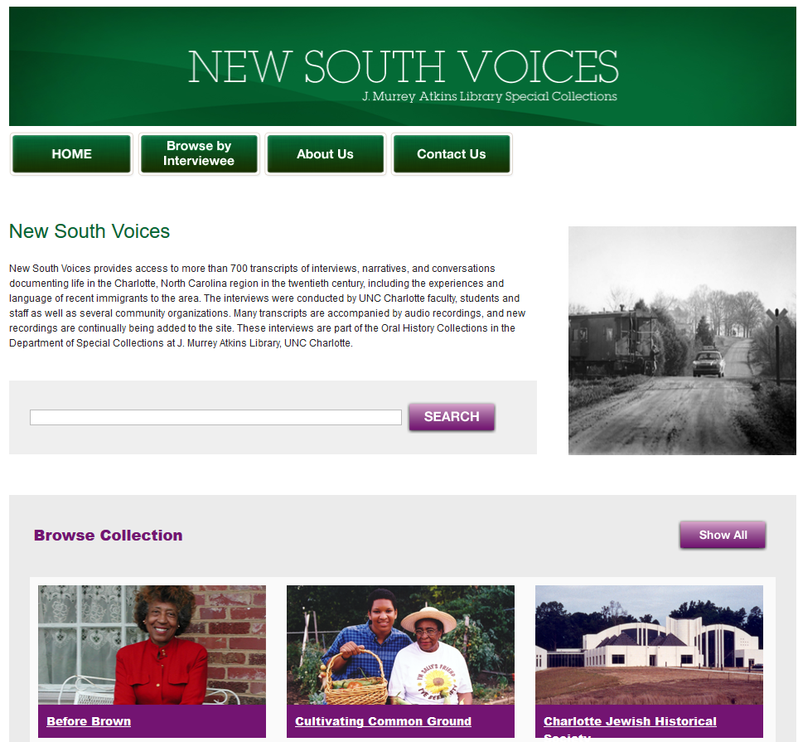
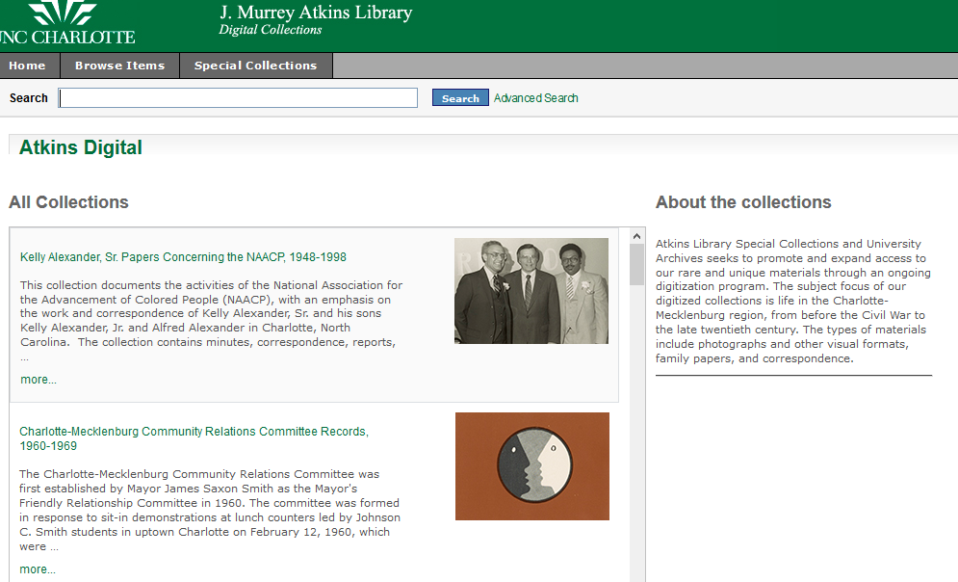
Migration from two old repositories…
Atkins Digital New South Voices (CONTENTdm)

Slide 6
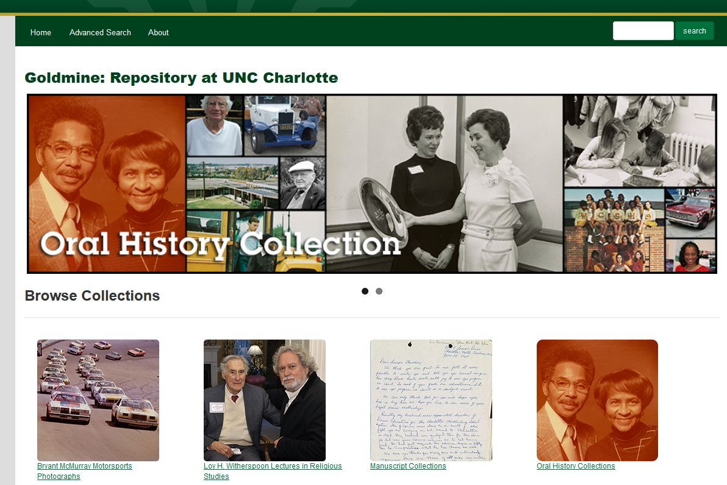
…to one new repository
Built on Islandora framework
Will eventually be the sole location for digital collections
Solution for both preservation and access

Slide 7
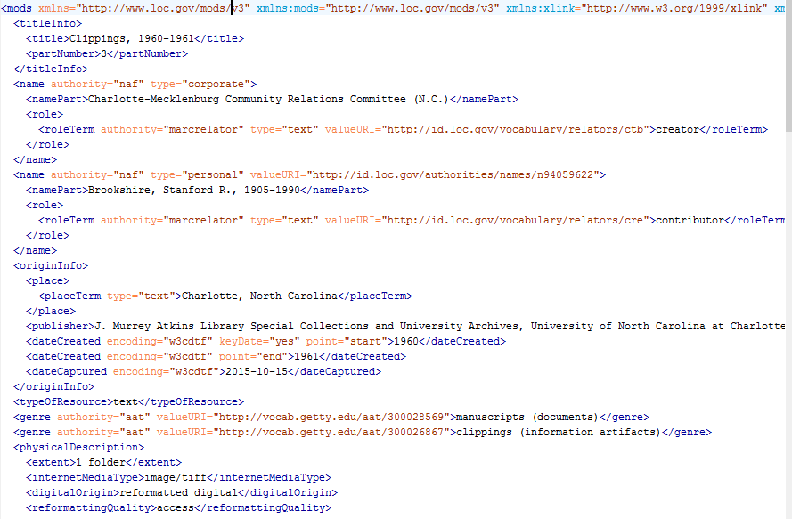
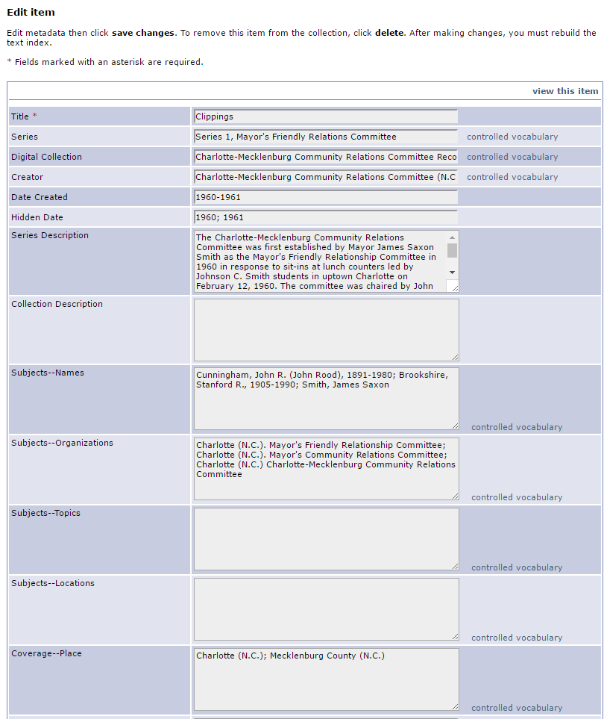
Transition to New Metadata Standard
http://www.loc.gov/standards/mods/
MODS
Serialized in XML
Similar to MARC
Very granular
Hierarchical
Attributes that refine meaning of elements

Slide 8
Project 1: Oral History Interviews
Descriptive practices already established, but needed tweaking
Modernized to fit needs of 2014-onward within staffing constraints

Slide 9
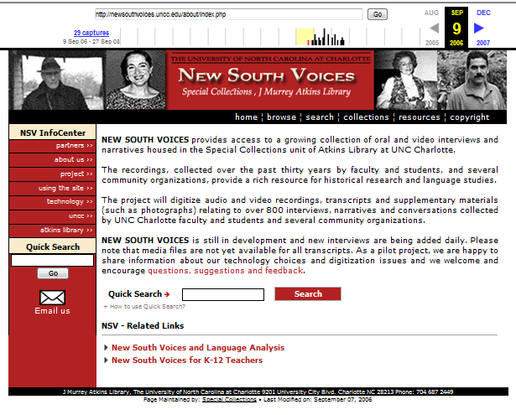
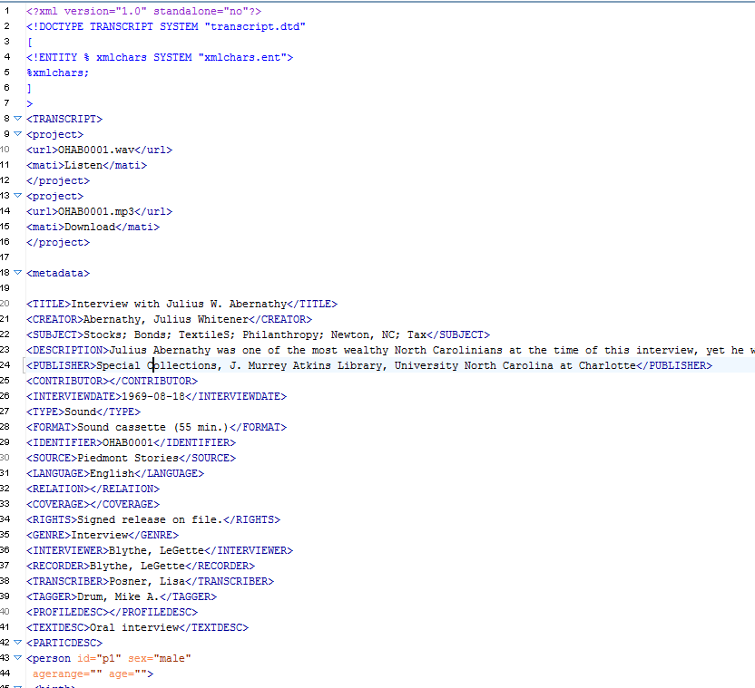
Digital Legacy of Oral History Program

Slide 10
Project 2: Motorsports Photographs
Newly acquired collection in 2014
Over 100,000 photographic images (negatives, slides, born-digital)
Had to learn and adapt along the way

Slide 11
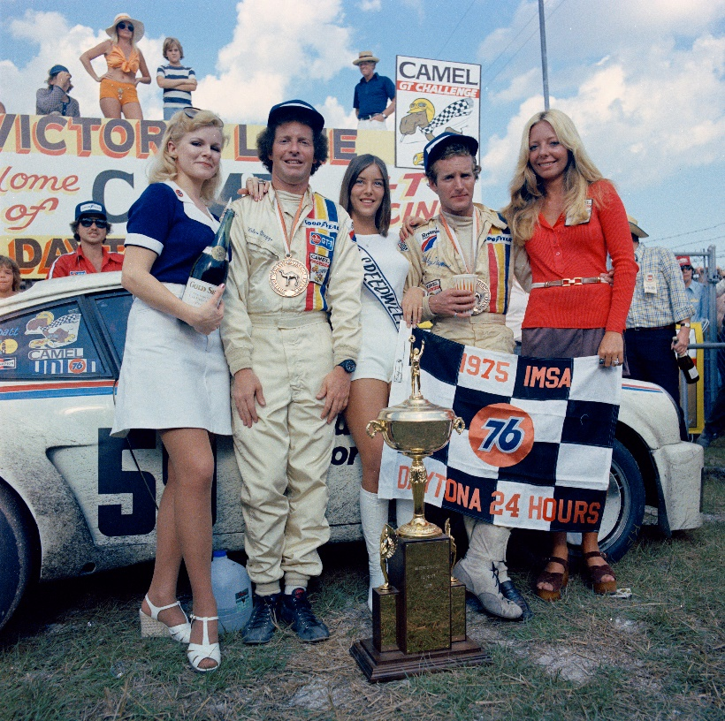
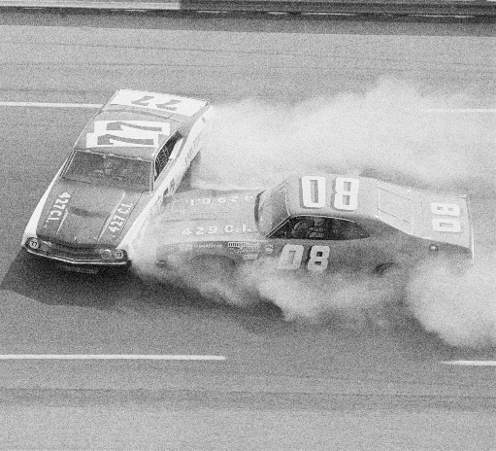
Motorsports: Brimming with Challenges/Opportunities
Notes:
Asked to digitize this collection as an enticement for the donor to donate his collection.
Digitization person (myself) was funded through a different grant that had nothing to do with motorsports, had to limit time spent on project till July 2016
Our first digitization project of negatives. Did not begin project with adequate equipment, all our images were blurry.
Donor willing to assist with metadata creation
However he was perhaps led to have unrealistic expectations about our rate of production.

Slide 12
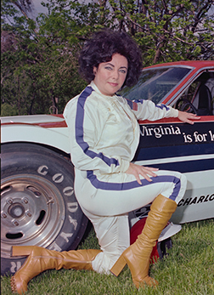
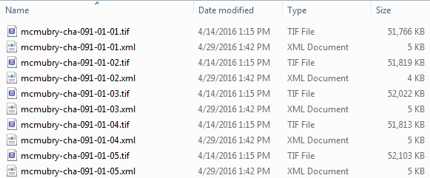
Motorsports Metadata Project
100,000+ images
Item-level metadata needed for every image
Controlled vocabulary for all persons identified, locations, racetracks, events
Donor metadata an essential ingredient
Greatest need:
Getting huge volume of metadata in spreadsheets
into MODS swiftly and painlessly
Also anticipated: Splitting large files of
MODS records in <modsCollection>
wrapper into individual <mods> files

Slide 13
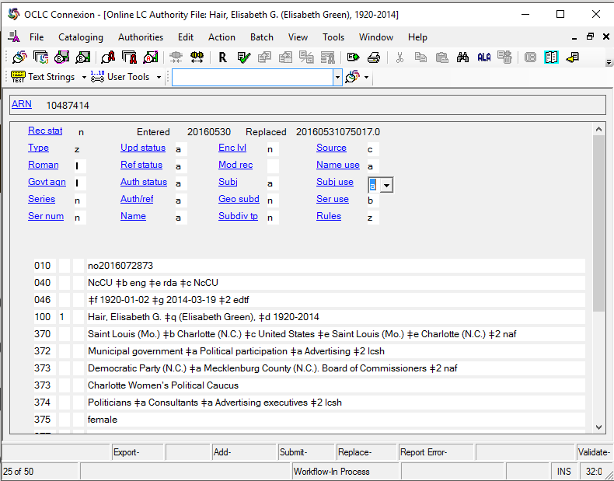
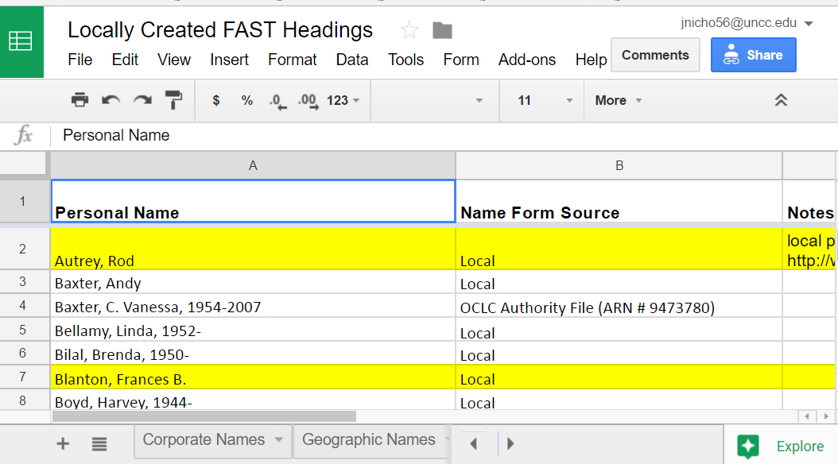
Oral Histories NACO Project
NAF name forms used for personal names in oral history project—but many don’t have records
Objective: Create NACO records for oral histories project names
Problem: How to use skills of non-catalogers working on project to create NACO records?

Slide 14
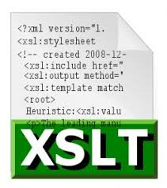
2 Projects, Similar Processes & Tools
Communication & Project Management
Metadata Creation
G Suite (Google)
Trello
FAST
Open Refine
XSLTs

Slide 15
G Suite

Slide 16
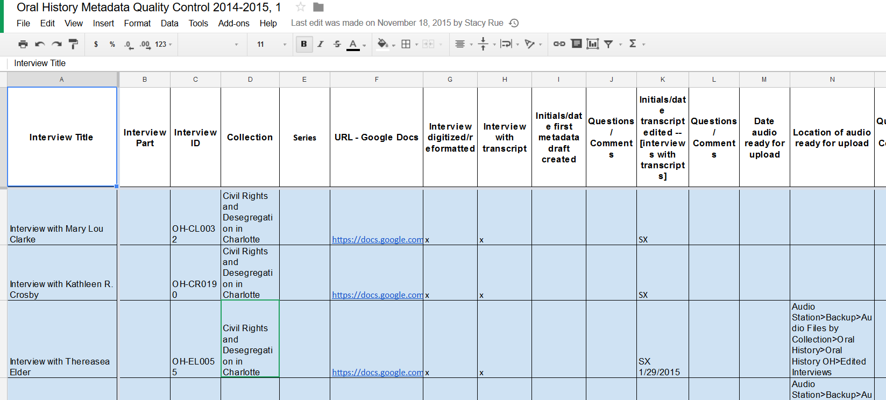
Introducing G Suite to Oral History Workflow
Sheets for tracking progress on interviews, eventually for staging of ingests
Docs to replace old .txt, .xml, and Word docs as working documents
Notes:
We started out slowly and introduced Sheets and Docs first, plus Drive of course.
When I started in 2013, our department had a shared Drive space, which became more widely adopted after
Mention advantages here:
Flexible set of tools for collaboration
Easy access by users with different permissions
By 2013, increasingly used across UNCC department and library

Slide 17
G Suite in the Motorsports Project
Multiple Sheets to capture donor’s original data, digitization information, and metadata. (some Excel too)
Advantages mentioned before: accessibility, multiple collaborators at once, versioning

Slide 18
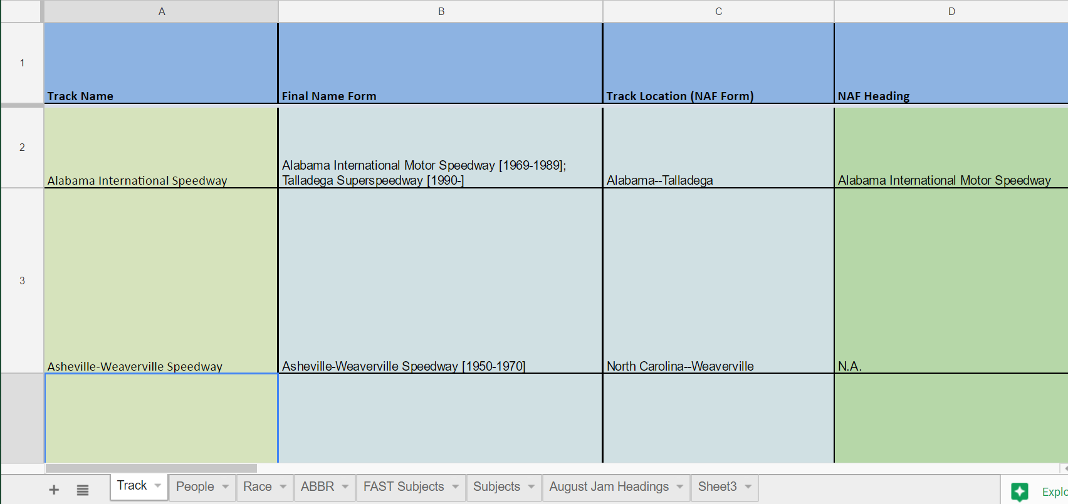
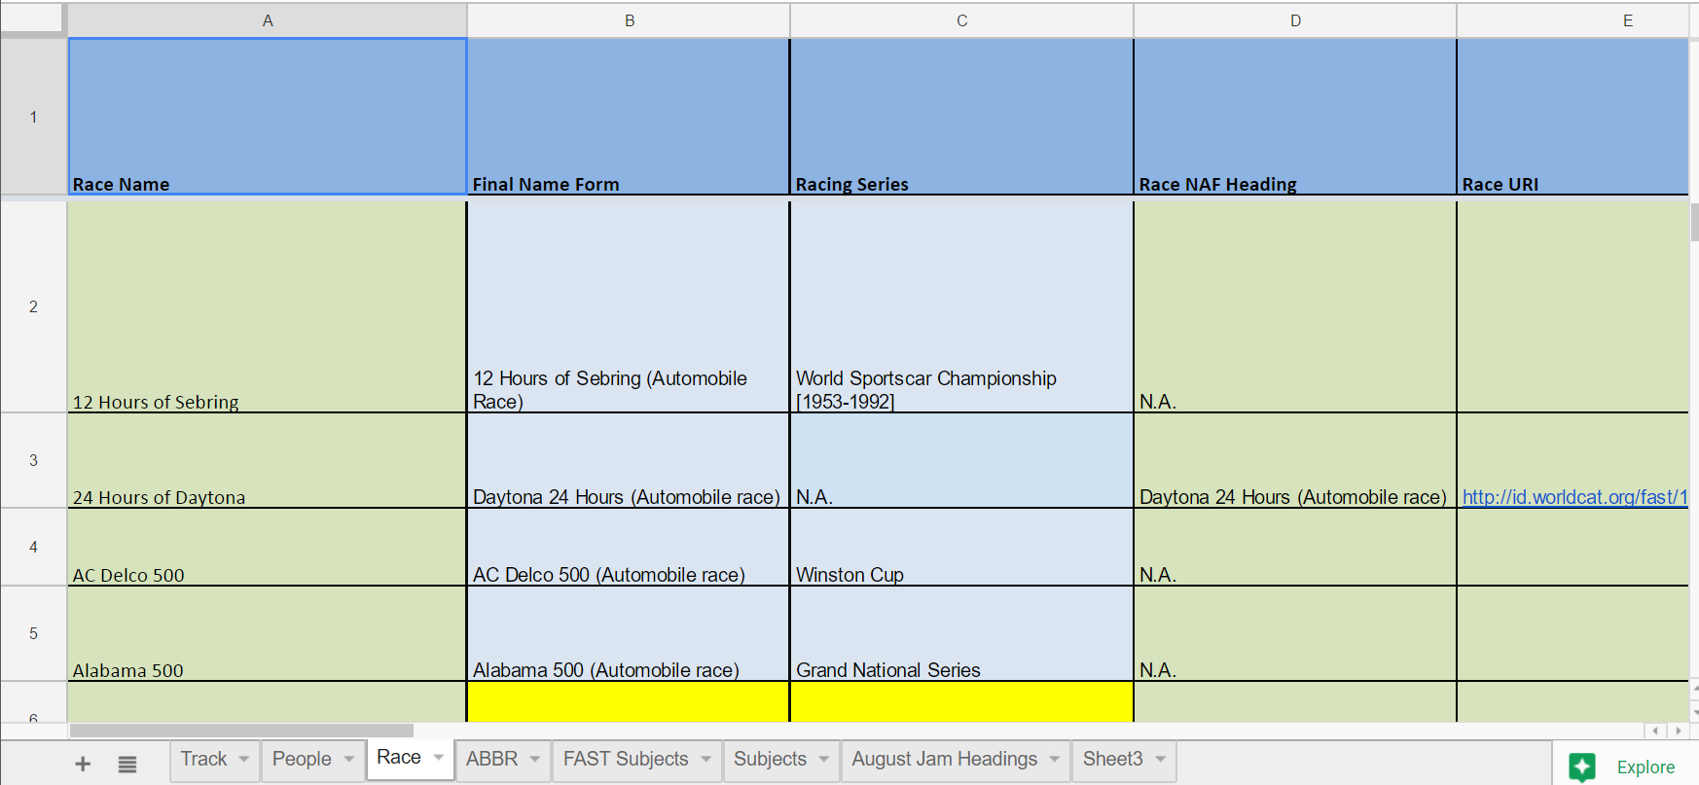
Motorsports Metadata Project: Authority Control
Multi-tabbed spreadsheet in Google Docs with controlled terms for people, tracks, race names, series

Slide 19
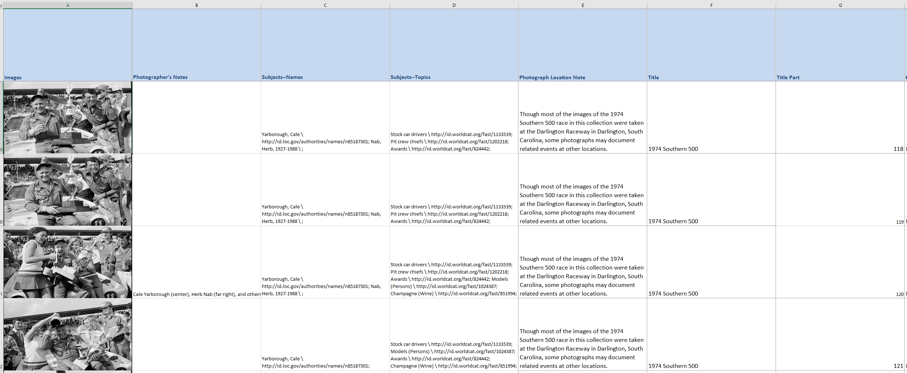
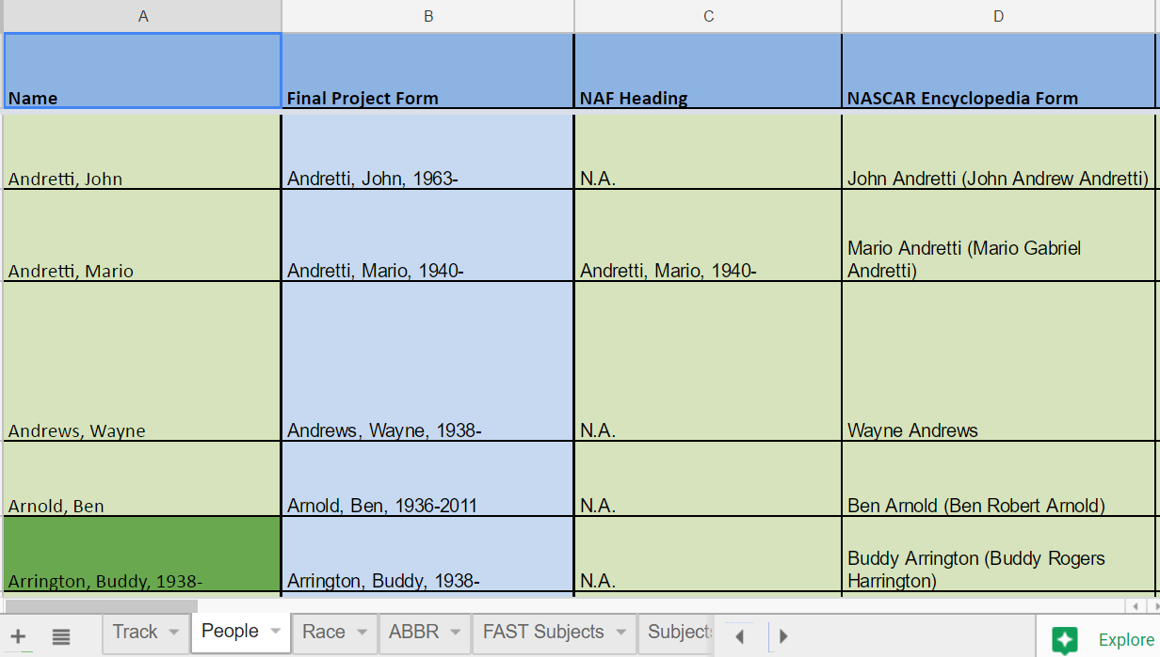
Motorsports Metadata Procedure: Excel
Images loaded into Excel spreadsheet
Each row represents a metadata record
Controlled vocab terms from Google
Docs spreadsheet
Problem: cells with multiple values

Slide 20
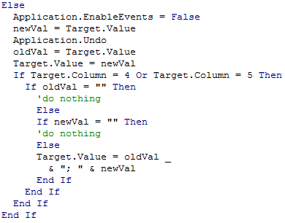
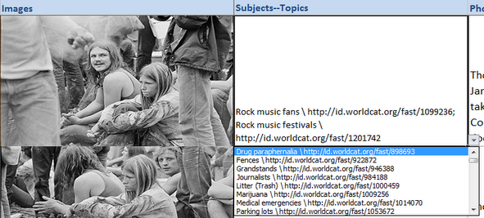
Motorsports Metadata Procedure: Excel Code
Tab 2 of spreadsheet: Controlled values inserted in columns
Tab 1 of spreadsheet: Dropdowns insert controlled terms from Tab 2 with a click (but code needed for multiple values per cell)

Slide 21
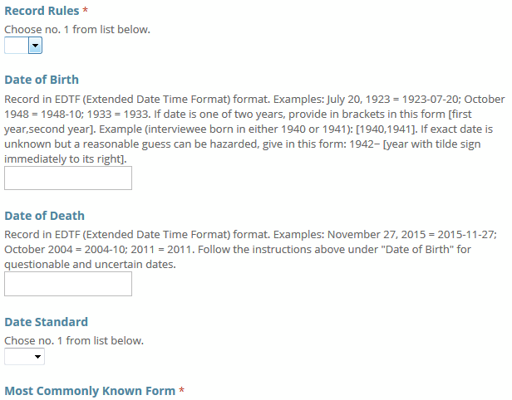
Authorities Project: Google Forms
Data entered in form is automatically transferred to Google spreadsheet

Slide 22
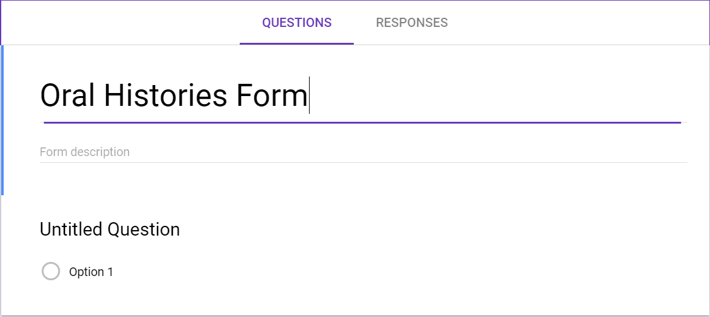
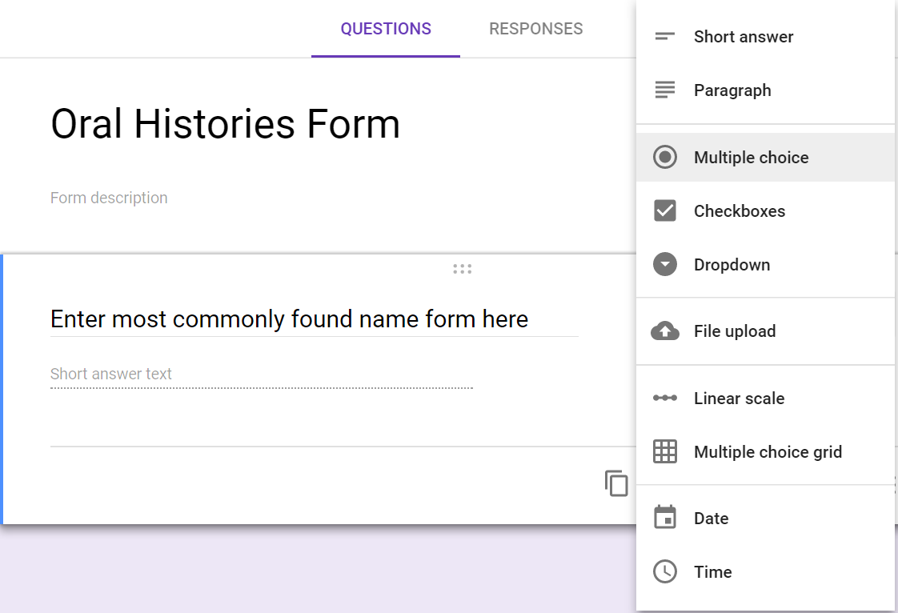
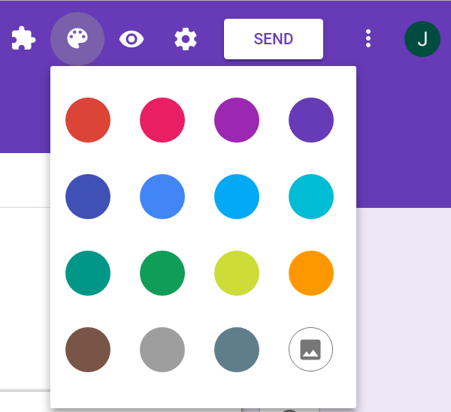
Creating a Google Form
1. Create form by choosing “blank” form from main screen
3. Give form a name
4. Begin creating questions—multiple choice, short answer, paragraph questions are options
5. Create additional questions by duplicating previous questions; choose if responses are required or not
2. Choose color palate and/or design template

Slide 23
Trello

Slide 24
Trello for Communication in Oral History
Notes:
Filled a need for communication that spreadsheet wasn’t accomplishing
Visual representation of each interview
Integrates with G Suite
Free, easy to use

Slide 25
Trello Card:
Oral History

Slide 26
Trello for Communication in Motorsports
Notes:
Creating a Trello board successful for OH, so I created one to manage digitization work for Motorsports as well
Many rotating students working on this project. Board makes it so they can come in and know what they can work on without asking a staff member.
Students use this alongside the digitization spreadsheet to do the work

Slide 27
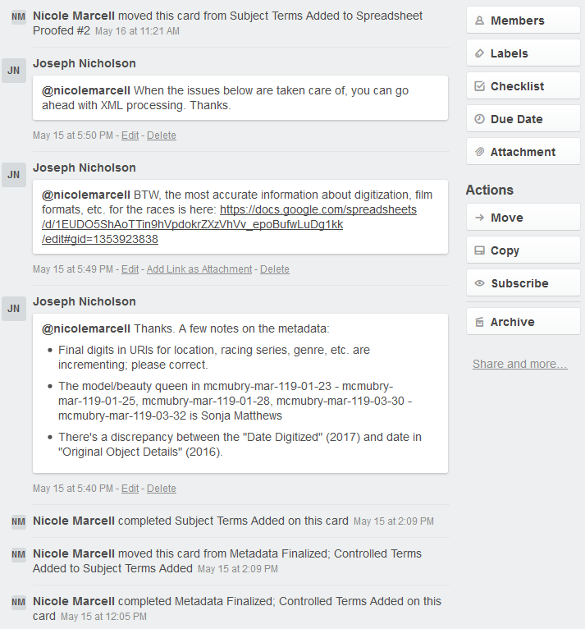
Trello Board: Motorsports Metadata Workflow
Comments in Twitter-like interface make communicating with project staff about particular tasks very simple

Slide 28
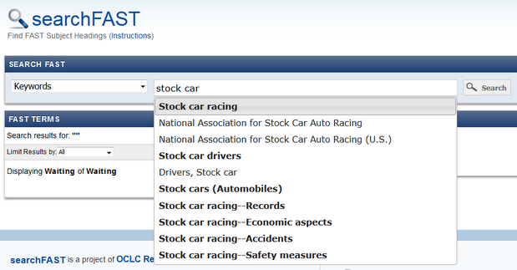
Transition to New Subject Vocabulary: FAST = Faceted Application of Subject Terminology
Needed:
Method of assigning subject terms that does not require deep training in LCSH
FAST:
Derived from Library of Congress Subject Headings (LCSH)
Geographical, topical, chronological, genre facets recorded as separate terms: no lengthy subject strings
Compatible with existing metadata
Users do not have to put complex LCSH strings together
FAST: http://fast.oclc.org/searchfast/
LCSH
Minorities
Romania--Transylvania
History--Sources
FAST

Slide 29
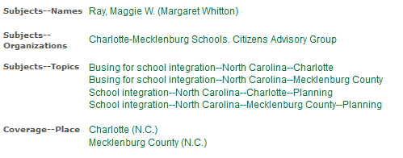
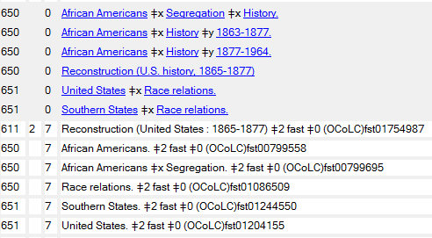
FAST: Gains and Losses
Old repository: LCSH
All project staff, including students, can assign with ease
Keyword searchable FAST interface
Accelerated workflows
Some loss of subject specificity
Browse searches compromised
New repository: FAST
LCSH
FAST

Slide 30
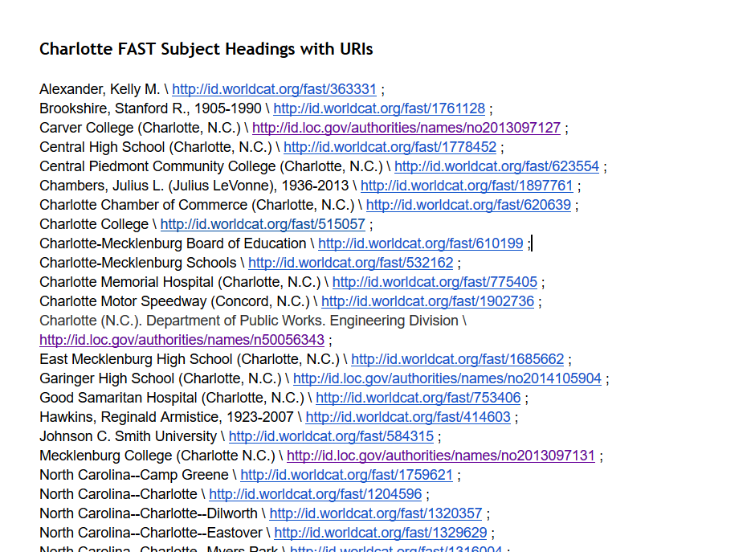
FAST: Application in Oral History Project
Simple enough for students and staff to apply
Can keep a running list of commonly used terms
Vast improvement over old keyword subject terms
We still use some terms not in FAST (but not topics)

Slide 31
OpenRefine
Freely available, easily downloadable tool for:
Data cleaning or wrangling
Transformation to other data formats
Adding data (reconciliation with data sets)
Interface very like Excel—but with more features
http://openrefine.org/

Slide 32
Motorsports Metadata Step 1: Create Spreadsheet, Import into OpenRefine, Create Project
1
2
3

Slide 33
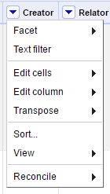
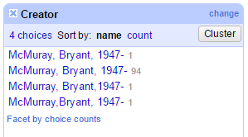
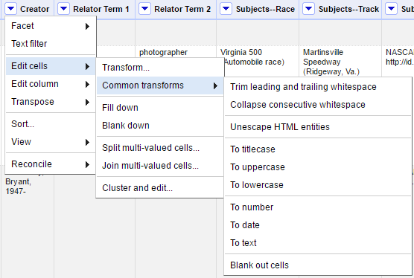
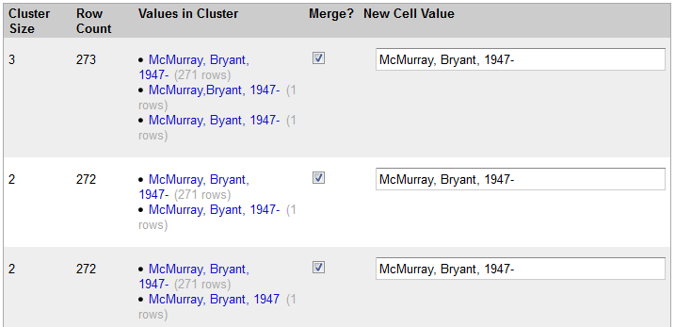
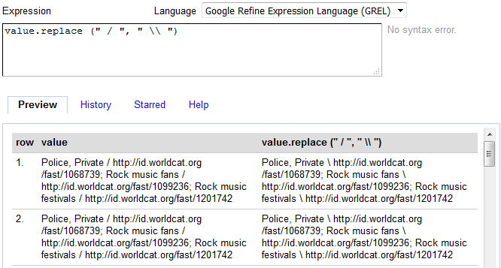
Motorsports Metadata Step 2: Clean Data
Quick transformations
Faceting
Google Refine Expression Language
Clustering

Slide 34
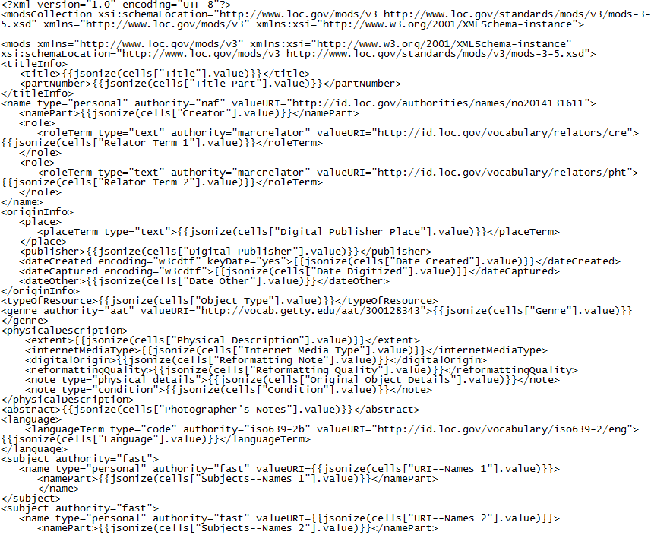
Motorsports Metadata Step 3: Creating the Template
Spreadsheet column titles are inserted inside MODS elements (sandwiched inside jsonize syntax). In the OpenRefine transformation, data in cells in those columns will be mapped to the designated MODS element.
<typeOfResource>{{jsonize(cells["Object Type"].value)}}</typeOfResource>

Slide 35
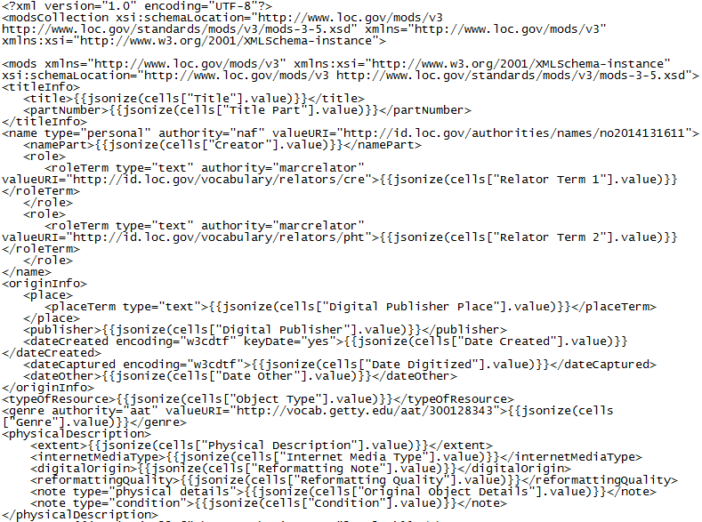
Motorsports Metadata Step 3 Continued
Column titles from spreadsheet must match column titles in template exactly—case-sensitive

Slide 36
Constant Data
Constant data—data that remains the same from record to record—can be included in template. Those elements will be applied to all records created through this process.

Slide 37
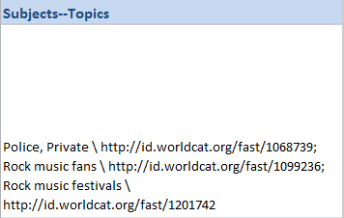
Splitting Rows with Multiple Values
Spreadsheet cells with multiple values must be split in OpenRefine so that each value is mapped to its own MODS element.

Slide 38
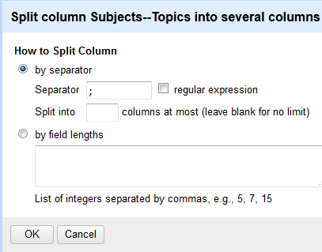
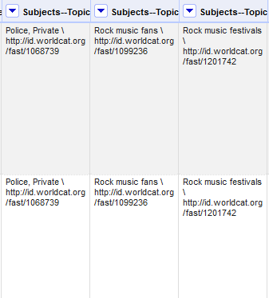
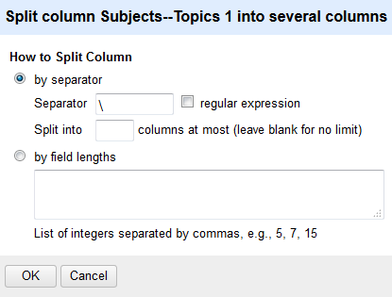
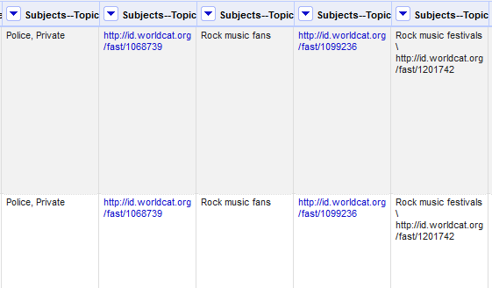
Splitting Columns of Data
Columns with multiple values split twice
After splitting, columns are renamed to match template spreadsheet

Slide 39
Transforming the Data
modsCollection root element here
Click on “Export” and then on “Templating”
2. Paste template in left side of
“Templating Export” boxes
modsCollection closing element here

Slide 40
Transforming the Data Continued

Slide 41
Post-Transformation Problems
Other major problem: large modsCollection file needs to be split into individual MODS records
Empty elements may appear in resulting XML file if metadata records contain fewer elements than were provided for in the template

Slide 42
XSLT = Extensible Stylesheet Language Transformations
Language that transforms XML documents
Transform one flavor/standard of metadata into another
Add, remove, change elements in a metadata file or
group of files
Clean up XML documents
Change XML into HTML—or embed elements from XML
document into HTML
Break up a large file into smaller files
XSLT documents can be very complex or simple, depending on
task that needs to be accomplished
Notes:
Can cut some content if short on time.

Slide 43
Problem 1: Empty Elements in XML File
Before transformation:
Empty elements
Simple XSLT identity transformation copies entire contents of file and normalizes spacing—i.e. removes empty elements and attributes
After transformation: empty elements stripped out

Slide 44
Problem 2: Large Metadata File Needs to be Split into Individual Records
Before transformation: 100+ records in single collection-level metadata file
xsl:result-document creates multiple new fie and inserts new root element. “href” attribute instructs XSLT to rename files with mods:identifier in each record
After transformation: collection-level file broken up into individual metadata records, each with identifier for image as filename

Slide 45
XSLT: Running the Transformation
1. Identify XML file you want to apply XSLT to
2. Choose destination for results of transformation (folder)
4. Results of transformation appear in folder
3. Click “apply associated”

Slide 46
XSLT: Building other stylesheets
1. Metadata standard-agnostic XSLT could apply to any XML metadata
2. New template added to manipulate MODS rights element; MODS namespace has to be dropped in root element
3. Additional template inserted to adjust geographical subjects

Slide 47
Google Form Data to Authority Records Step 1
MARCXML Metadata Template
OpenRefine Transformation

Slide 48
Google Form Data to Authority Records Step 2
“Cleaning” XSLT applied
MARCEdit used to transform MARXML file to MARC21

Slide 49
Google Form Data to Authority Records: Results
Method of capturing NACO data from other workflows
Records can be transformed into MADS for repository via separate XSLT
(Nota bene --Records are of course checked carefully before submission to NAF)

Slide 50
End Product: Motorsports Metadata Display

Slide 51
End Product: Oral History Metadata Display

Slide 52
Conclusion
Free & cheap tools that have worked for us:
G Suite
Trello
FAST
OpenRefine
XSLT

Slide 53
Thank You!
Rita Johnston, Digital Production Librarian, UNC Charlotte
Joseph Nicholson, Metadata Librarian, UNC Charlotte

